Slide 1

Tectonic Hazards
Environment & Empire
A-Level Geography
CASE STUDY
Pakistan
Notes:
TEACHER NOTES
The aim of each teaching resource in this pack is to encourage students to explore:
The effects and consequences of empire on geography
The contributions of non-European people to the study of geography
The aim is therefore to both decolonise and diversify the teaching of geography.
SENSITIVITY GUIDANCE
Some students, particularly those with family in Pakistan or India, may have been personally affected by the events described in this case—both the history of colonialism and potentially the especially the more recent earthquakes in Pakistan.
We advise that students are informed in advance about the content, but also empowered, where they feel comfortable to share their own experiences and perspectives.
SPECIFICATION
AQA A-Level Geography
3.1.1 Section A: The challenge of natural hazards
Nature, forms and potential impacts of natural hazards (geophysical, atmospheric and hydrological).
Hazard perception and its economic and cultural determinants.
Characteristic human responses – fatalism, prediction, adjustment/adaptation, mitigation, management, risk sharing – and their relationship to hazard incidence, intensity, magnitude, distribution and level of development.
3.1.5.2 Plate tectonics
Earth structure and internal energy sources.
Plate tectonic theory of crustal evolution: tectonic plates; plate movement; gravitational sliding; ridge push, slab pull; convection currents and sea- floor spreading.
Destructive, constructive and conservative plate margins.
3.1.5.4 Seismic hazards
The nature of seismicity and its relation to plate tectonics: forms of seismic hazard: earthquakes, shockwaves, tsunamis, liquefaction, landslides.
Spatial distribution, randomness, magnitude, frequency, regularity, predictability of hazard events.
Impacts: primary/secondary; environmental, social, economic, political.
Short and long-term responses; risk management designed to reduce the impacts of the hazard through preparedness, mitigation, prevention and adaptation.
Impacts and human responses as evidenced by a recent seismic event.
COPYRIGHT AND TERMS
All content is provided under the Creative Commons Attribution 4.0 license: https://creativecommons.org/licenses/by/4.0/
Images rights are held by respective copyright holders
For further information about the project, please see https://environmentandempire.org.uk/

Slide 2
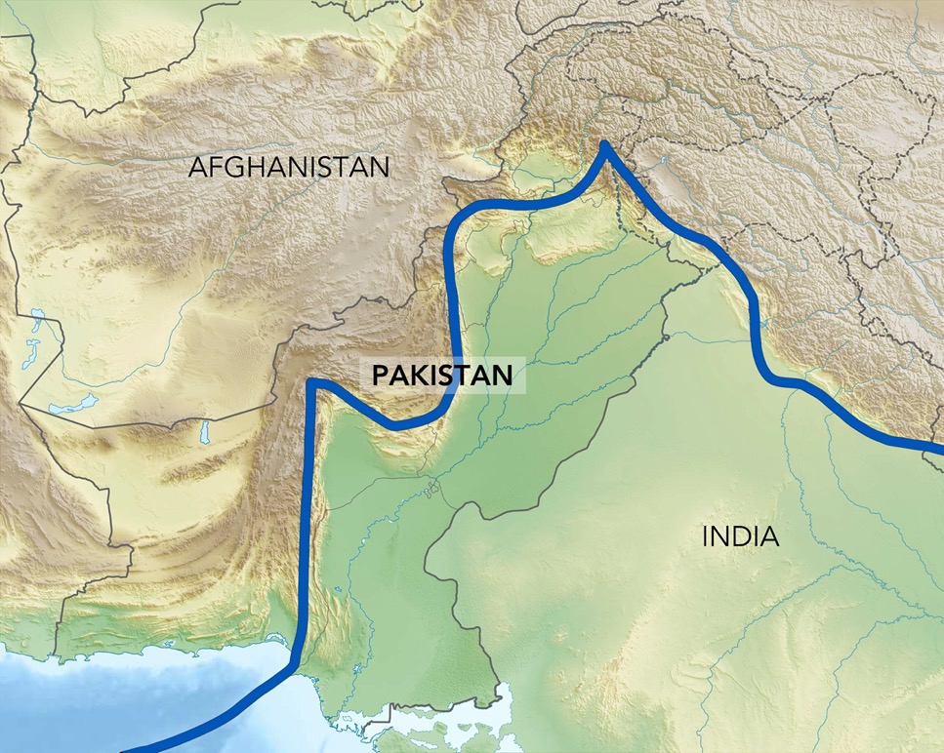
Earthquakes in Pakistan
Pakistan is located where the Eurasian and Indian tectonic plates meet.
On average, Pakistan experiences 250 earthquakes with a magnitude above 4 M_{w} per year.
In 2005 Pakistan experienced an earthquake of magnitude 7.6 M_{w} in the region of Kashmir.
86,000 people were killed in the 2005 Kashmir earthquake.
The blue line represents division between Eurasian and Indian tectonic plates.
Notes:
SPECIFICATION
AQA A-Level Geography
3.1.1 Section A: The challenge of natural hazards
Nature, forms and potential impacts of natural hazards (geophysical, atmospheric and hydrological).
Hazard perception and its economic and cultural determinants.
Characteristic human responses – fatalism, prediction, adjustment/adaptation, mitigation, management, risk sharing – and their relationship to hazard incidence, intensity, magnitude, distribution and level of development.
3.1.5.2 Plate tectonics
Earth structure and internal energy sources.
Plate tectonic theory of crustal evolution: tectonic plates; plate movement; gravitational sliding; ridge push, slab pull; convection currents and sea- floor spreading.
Destructive, constructive and conservative plate margins.
3.1.5.4 Seismic hazards
The nature of seismicity and its relation to plate tectonics: forms of seismic hazard: earthquakes, shockwaves, tsunamis, liquefaction, landslides.
Spatial distribution, randomness, magnitude, frequency, regularity, predictability of hazard events.
Impacts: primary/secondary; environmental, social, economic, political.
Short and long-term responses; risk management designed to reduce the impacts of the hazard through preparedness, mitigation, prevention and adaptation.
Impacts and human responses as evidenced by a recent seismic event.
3.1.5.7 Case studies
Case study of a multi-hazardous environment beyond the UK to illustrate and analyse the nature of the hazards and the social, economic and environmental risks presented, and how human qualities and responses such as resilience, adaptation, mitigation and management contribute to its continuing human occupation.

Slide 3
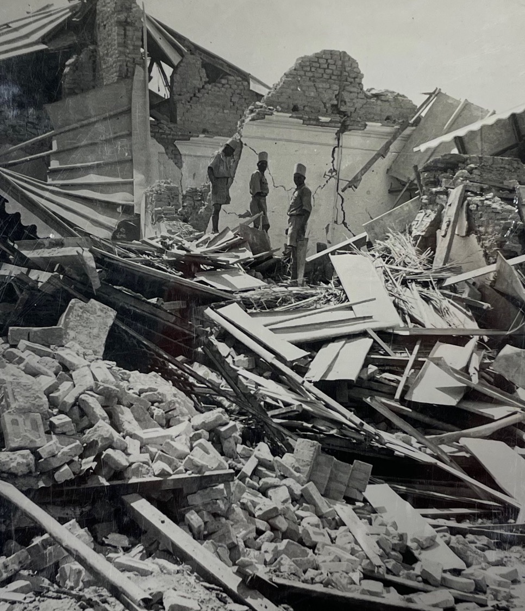
Earthquakes and Empire in Pakistan
Pakistan was part of the British Empire, within British India, up until independence in 1947.
In 1935 an earthquake with magnitude of 7.7 M_{w} struck near the city of Quetta.
The 1935 Quetta earthquake killed between 30,000 and 60,000 people.
What were the effects and responses to an earthquake under British colonialism?
Photograph of 1935 Quetta Earthquake (C. P. Skrine / Royal Geographical Society)
Notes:
SPECIFICATION
AQA A-Level Geography
3.1.1 Section A: The challenge of natural hazards
Nature, forms and potential impacts of natural hazards (geophysical, atmospheric and hydrological).
Hazard perception and its economic and cultural determinants.
Characteristic human responses – fatalism, prediction, adjustment/adaptation, mitigation, management, risk sharing – and their relationship to hazard incidence, intensity, magnitude, distribution and level of development.
3.1.5.4 Seismic hazards
The nature of seismicity and its relation to plate tectonics: forms of seismic hazard: earthquakes, shockwaves, tsunamis, liquefaction, landslides.
Spatial distribution, randomness, magnitude, frequency, regularity, predictability of hazard events.
Impacts: primary/secondary; environmental, social, economic, political.
Short and long-term responses; risk management designed to reduce the impacts of the hazard through preparedness, mitigation, prevention and adaptation.
Impacts and human responses as evidenced by a recent seismic event.
3.1.5.7 Case studies
Case study of a multi-hazardous environment beyond the UK to illustrate and analyse the nature of the hazards and the social, economic and environmental risks presented, and how human qualities and responses such as resilience, adaptation, mitigation and management contribute to its continuing human occupation.

Slide 4
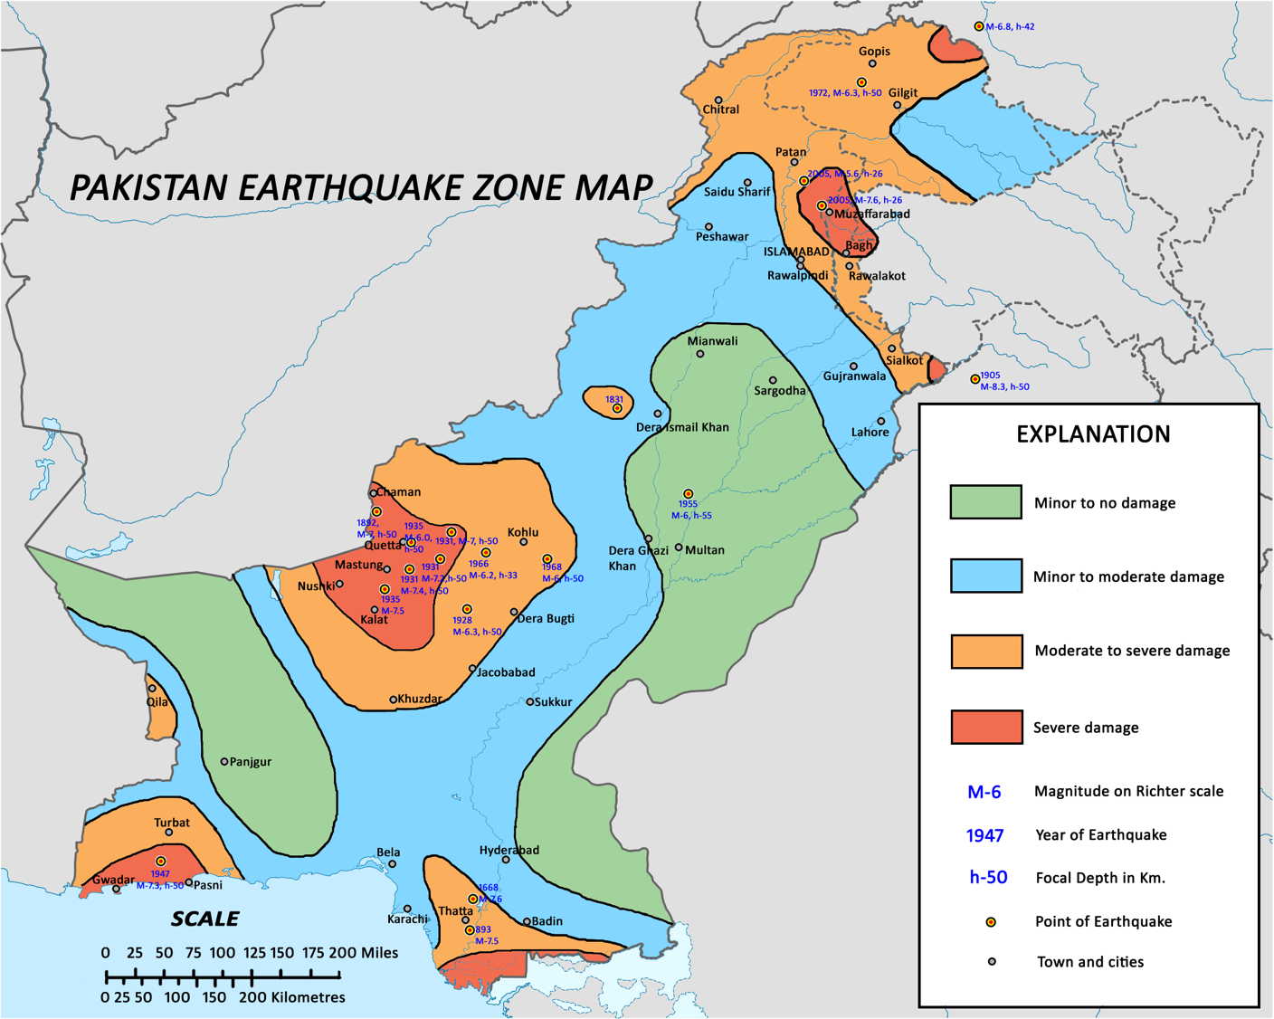
Notes:
TEACHER NOTES
Identify for students the location of the 1935 Quetta earthquake and the 2005 Kashmir earthquake (near Muzaffarabad).
Copy of the earthquake map available (free): https://en.wikipedia.org/wiki/List_of_earthquakes_in_Pakistan#/media/File:Sesimic_hazard_zones_of-Pakistan.png
SPECIFICATION
AQA A-Level Geography
3.1.5.2 Plate tectonics
Earth structure and internal energy sources.
Plate tectonic theory of crustal evolution: tectonic plates; plate movement; gravitational sliding; ridge push, slab pull; convection currents and sea- floor spreading.
Destructive, constructive and conservative plate margins.
3.1.5.4 Seismic hazards
The nature of seismicity and its relation to plate tectonics: forms of seismic hazard: earthquakes, shockwaves, tsunamis, liquefaction, landslides.
Spatial distribution, randomness, magnitude, frequency, regularity, predictability of hazard events.
Impacts: primary/secondary; environmental, social, economic, political.
Short and long-term responses; risk management designed to reduce the impacts of the hazard through preparedness, mitigation, prevention and adaptation.
Impacts and human responses as evidenced by a recent seismic event.
3.1.5.7 Case studies
Case study of a multi-hazardous environment beyond the UK to illustrate and analyse the nature of the hazards and the social, economic and environmental risks presented, and how human qualities and responses such as resilience, adaptation, mitigation and management contribute to its continuing human occupation.

Slide 5
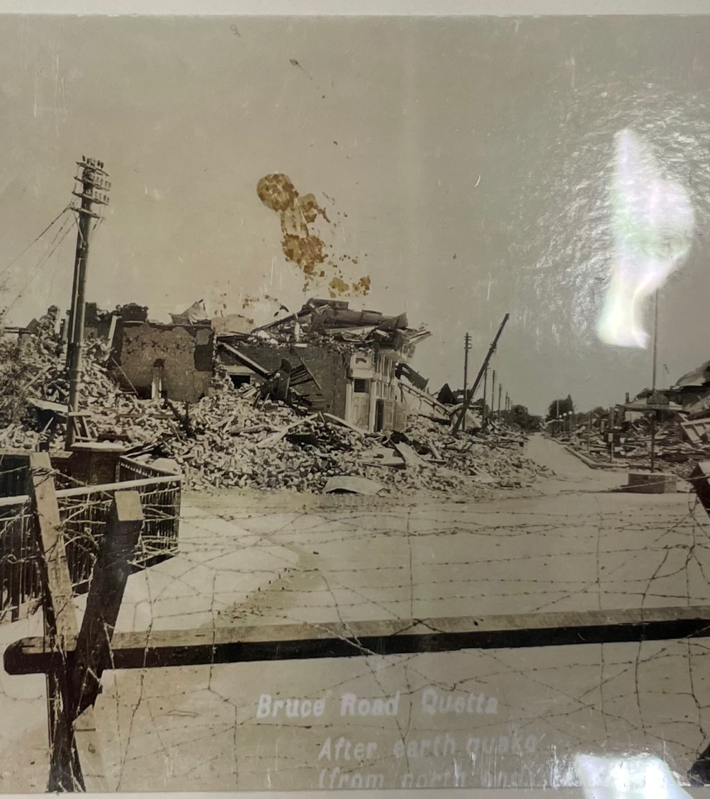
Effects
1935 Quetta Earthquake
3.03am, 31 May 1935, British India (now Pakistan).
7.7 M_{w} magnitude.
Main shock lasted for around 3 minutes.
Large aftershocks continued until at least 2 June 1935.
Between 30,000 and 60,000 people killed.
Over 14,000 houses damaged.
31,500 people displaced.
Railway lines damaged.
Photograph of 1935 Quetta Earthquake (T. R. J. Ward / Royal Geographical Society)
Notes:
TEACHER NOTES
For a detailed account of effects and responses to the 1935 Quetta earthquake, see the following:
Haines, Daniel (May 2019). "Historical Case Study: India 1935: Earthquake" (PDF). Shelter Projects 2017-2018. Global Shelter Cluster. https://www.shelterprojects.org/shelterprojects2017-2018/SP17-18_B01-India-Quetta-1935.pdf
SPECIFICATION
AQA A-Level Geography
3.1.1 Section A: The challenge of natural hazards
Nature, forms and potential impacts of natural hazards (geophysical, atmospheric and hydrological).
Hazard perception and its economic and cultural determinants.
Characteristic human responses – fatalism, prediction, adjustment/adaptation, mitigation, management, risk sharing – and their relationship to hazard incidence, intensity, magnitude, distribution and level of development.
3.1.5.2 Plate tectonics
Earth structure and internal energy sources.
Plate tectonic theory of crustal evolution: tectonic plates; plate movement; gravitational sliding; ridge push, slab pull; convection currents and sea- floor spreading.
Destructive, constructive and conservative plate margins.
3.1.5.4 Seismic hazards
The nature of seismicity and its relation to plate tectonics: forms of seismic hazard: earthquakes, shockwaves, tsunamis, liquefaction, landslides.
Spatial distribution, randomness, magnitude, frequency, regularity, predictability of hazard events.
Impacts: primary/secondary; environmental, social, economic, political.
Short and long-term responses; risk management designed to reduce the impacts of the hazard through preparedness, mitigation, prevention and adaptation.
Impacts and human responses as evidenced by a recent seismic event.
3.1.5.7 Case studies
Case study of a multi-hazardous environment beyond the UK to illustrate and analyse the nature of the hazards and the social, economic and environmental risks presented, and how human qualities and responses such as resilience, adaptation, mitigation and management contribute to its continuing human occupation.

Slide 6
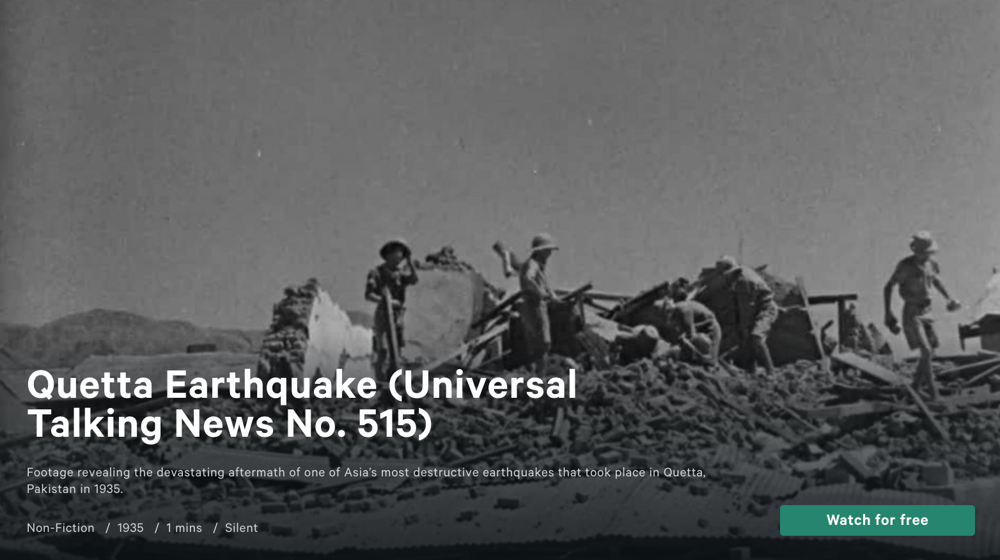
Photograph of 1935 Quetta Earthquake (Royal Geographical Society)
Notes:
TEACHER NOTES
Click image above or copy direct link to BFI Film Player (Free): https://player.bfi.org.uk/free/film/watch-quetta-earthquake-universal-talking-news-no-515-1935-online
1 minute silent film documenting the 1935 Quetta earthquake.
Ask the students to pay attention to effects and responses to the earthquake.
SPECIFICATION
AQA A-Level Geography
3.1.5.4 Seismic hazards
The nature of seismicity and its relation to plate tectonics: forms of seismic hazard: earthquakes, shockwaves, tsunamis, liquefaction, landslides.
Spatial distribution, randomness, magnitude, frequency, regularity, predictability of hazard events.
Impacts: primary/secondary; environmental, social, economic, political.
Short and long-term responses; risk management designed to reduce the impacts of the hazard through preparedness, mitigation, prevention and adaptation.
Impacts and human responses as evidenced by a recent seismic event.
3.1.5.7 Case studies
Case study of a multi-hazardous environment beyond the UK to illustrate and analyse the nature of the hazards and the social, economic and environmental risks presented, and how human qualities and responses such as resilience, adaptation, mitigation and management contribute to its continuing human occupation.

Slide 7
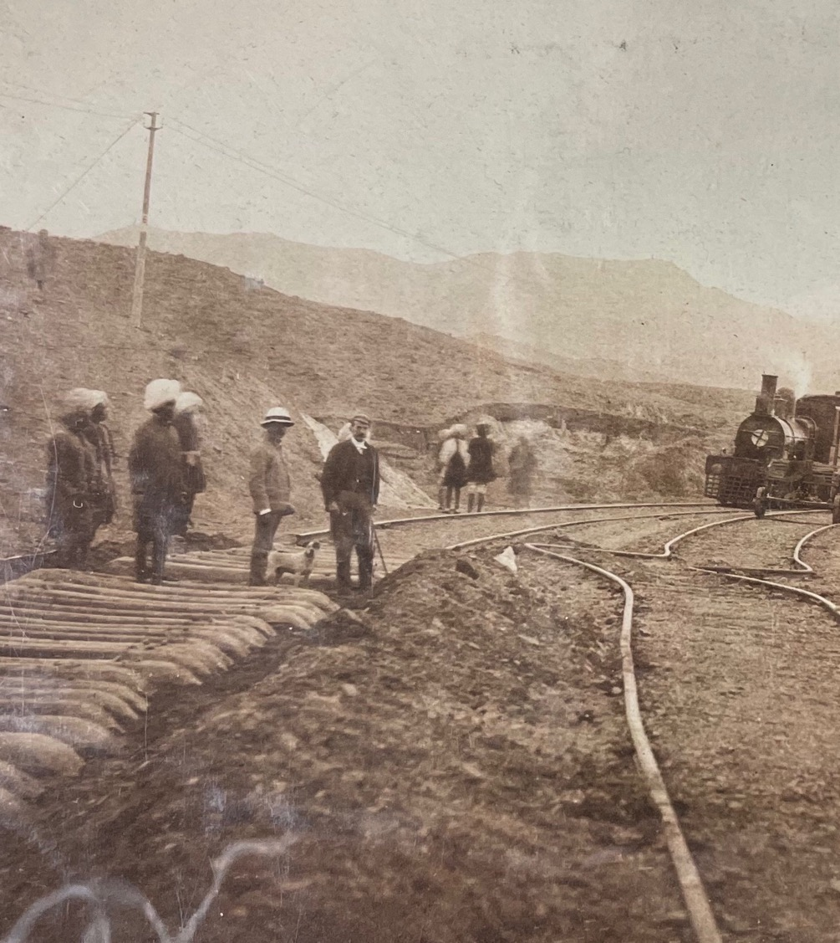
Responses
1935 Quetta Earthquake
Immediate
British colonial army mobilised.
Emergency camp established.
Health cordon established to stop spread of disease.
Evacuation of 31,500 people.
Relief fund established.
Long-term
New building code established.
Reconstruction of city of Quetta.
Relief fund and insurance claims assessed and paid.
Photograph of 1893 Baluchistan Earthquake (Waterhouse / Royal Geographical Society)
Notes:
TEACHER NOTES
For a detailed account of effects and responses to the 1935 Quetta earthquake, see the following:
Haines, Daniel (May 2019). "Historical Case Study: India 1935: Earthquake" (PDF). Shelter Projects 2017-2018. Global Shelter Cluster. https://www.shelterprojects.org/shelterprojects2017-2018/SP17-18_B01-India-Quetta-1935.pdf
The new building code was enforced by the colonial government, but only locally in Quetta, not across British India.
The building code required use of cement and steel rods, concrete roofs, maximum two stories for offices, square-shaped. Local people and property owners protested against the increased costs of building.
SPECIFICATION
AQA A-Level Geography
3.1.5.4 Seismic hazards
The nature of seismicity and its relation to plate tectonics: forms of seismic hazard: earthquakes, shockwaves, tsunamis, liquefaction, landslides.
Spatial distribution, randomness, magnitude, frequency, regularity, predictability of hazard events.
Impacts: primary/secondary; environmental, social, economic, political.
Short and long-term responses; risk management designed to reduce the impacts of the hazard through preparedness, mitigation, prevention and adaptation.
Impacts and human responses as evidenced by a recent seismic event.
3.1.5.7 Case studies
Case study of a multi-hazardous environment beyond the UK to illustrate and analyse the nature of the hazards and the social, economic and environmental risks presented, and how human qualities and responses such as resilience, adaptation, mitigation and management contribute to its continuing human occupation.

Slide 8
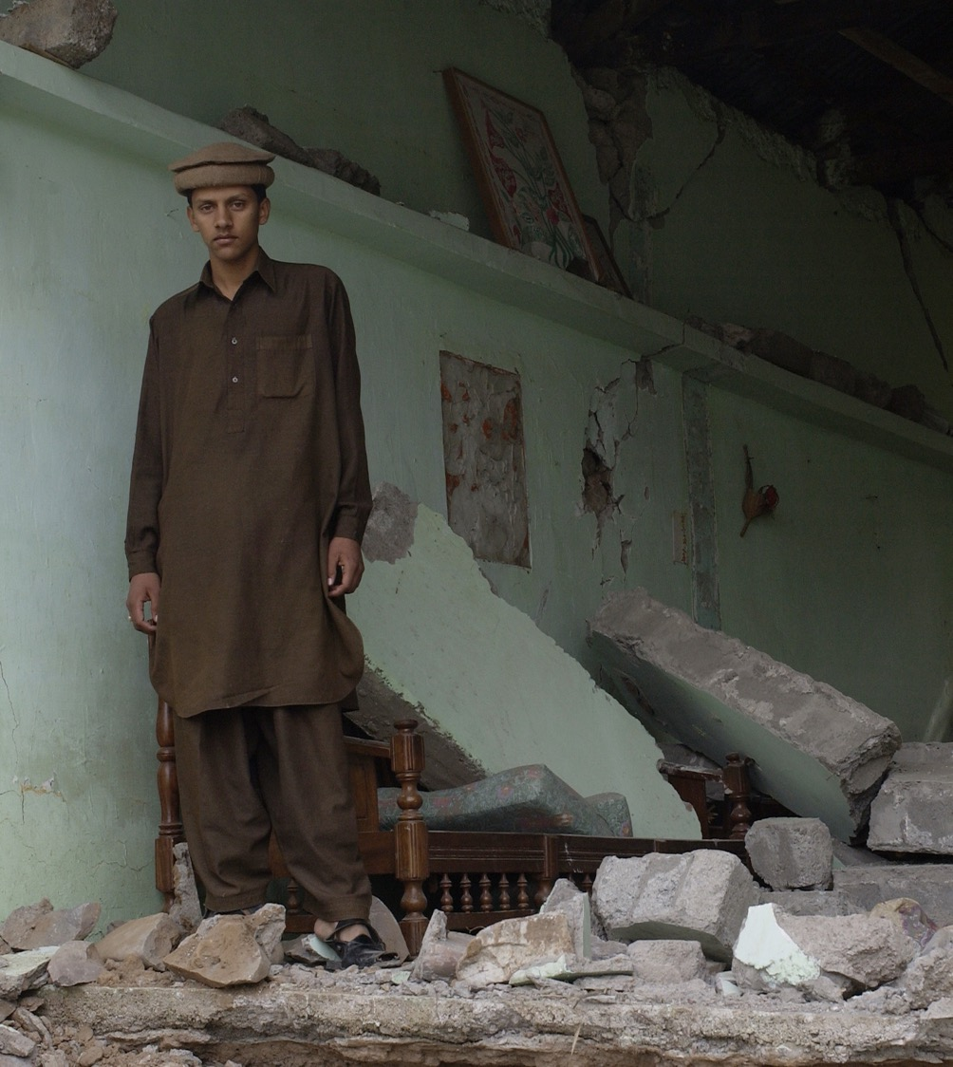
Earthquakes After Independence
Pakistan gained independence from the British Empire in 1947.
The Geological Survey of Pakistan was established in 1947.
Since 1947, Pakistani geographers have played an important role in:
  Understanding earthquakes
  Managing the risk of earthquakes
Pakistan received international aid to support response to 2005 Kashmir earthquake.
Photograph of 2005 Kashmir earthquake (Wikimedia)
Notes:
SPECIFICATION
AQA A-Level Geography
3.1.1 Section A: The challenge of natural hazards
Nature, forms and potential impacts of natural hazards (geophysical, atmospheric and hydrological).
Hazard perception and its economic and cultural determinants.
Characteristic human responses – fatalism, prediction, adjustment/adaptation, mitigation, management, risk sharing – and their relationship to hazard incidence, intensity, magnitude, distribution and level of development.
3.1.5.2 Plate tectonics
Earth structure and internal energy sources.
Plate tectonic theory of crustal evolution: tectonic plates; plate movement; gravitational sliding; ridge push, slab pull; convection currents and sea- floor spreading.
Destructive, constructive and conservative plate margins.
3.1.5.4 Seismic hazards
The nature of seismicity and its relation to plate tectonics: forms of seismic hazard: earthquakes, shockwaves, tsunamis, liquefaction, landslides.
Spatial distribution, randomness, magnitude, frequency, regularity, predictability of hazard events.
Impacts: primary/secondary; environmental, social, economic, political.
Short and long-term responses; risk management designed to reduce the impacts of the hazard through preparedness, mitigation, prevention and adaptation.
Impacts and human responses as evidenced by a recent seismic event.
3.1.5.7 Case studies
Case study of a multi-hazardous environment beyond the UK to illustrate and analyse the nature of the hazards and the social, economic and environmental risks presented, and how human qualities and responses such as resilience, adaptation, mitigation and management contribute to its continuing human occupation.

Slide 9
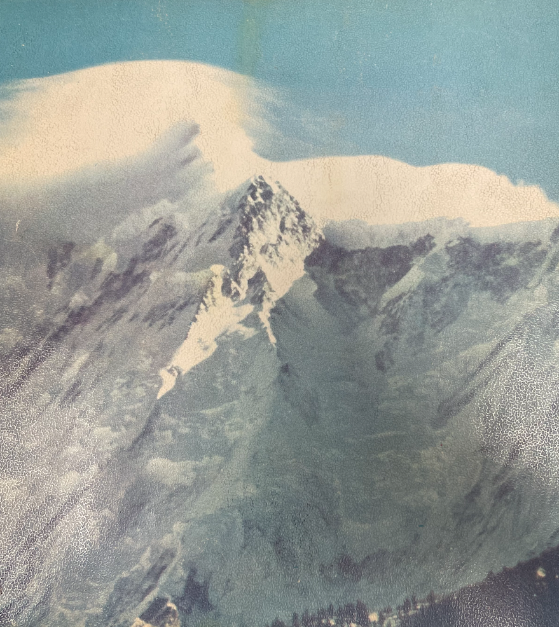

Rashid Ahmed Khan Tahirkheli
Studied at Aligarh Muslim University, British India in 1940s.
Completed PhD at University of St. Andrews, UK in 1960s.
Establishes National Centre of Excellence in Geology, Pakistan, in 1970s.
Collaborated with international organisations to increase funding and education.
Geology of the Himalaya by R. A. Khan Tahirkheli (Royal Geographical Society)
Notes:
TEACHER NOTES
Highlight the following to students:
Tahirkheli’s career shows the importance of institution building, funding, education, and training for the planning and management of tectonic risk.
Tahirkheli worked a lot with the Royal Geographical Society in London, helping to co-organise the 1980 International Karakorum Project (with British and Chinese geologists).
SPECIFICATION
AQA A-Level Geography
3.1.5.4 Seismic hazards
The nature of seismicity and its relation to plate tectonics: forms of seismic hazard: earthquakes, shockwaves, tsunamis, liquefaction, landslides.
Spatial distribution, randomness, magnitude, frequency, regularity, predictability of hazard events.
Impacts: primary/secondary; environmental, social, economic, political.
Short and long-term responses; risk management designed to reduce the impacts of the hazard through preparedness, mitigation, prevention and adaptation.
Impacts and human responses as evidenced by a recent seismic event.
3.1.5.7 Case studies
Case study of a multi-hazardous environment beyond the UK to illustrate and analyse the nature of the hazards and the social, economic and environmental risks presented, and how human qualities and responses such as resilience, adaptation, mitigation and management contribute to its continuing human occupation.

Slide 10
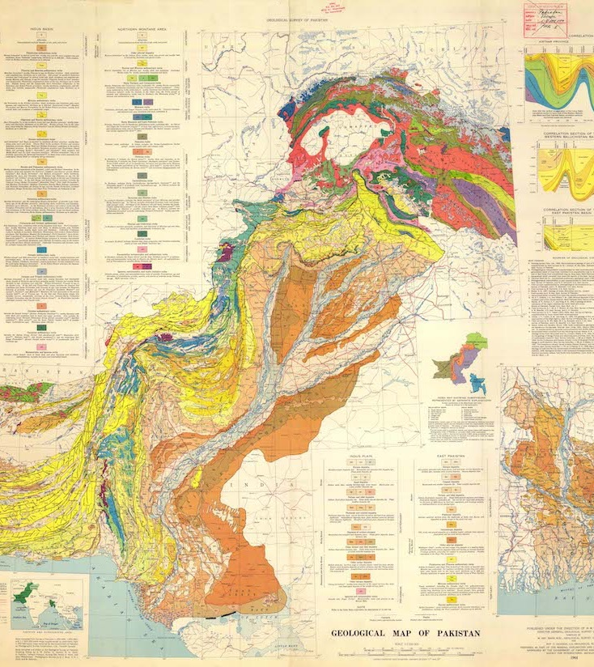

Ali Hamza Kazmi
Studied at University of Lucknow, British India in 1940s.
Further study at Imperial College London, UK in 1950s.
Worked for Geological Survey of Pakistan.
Published Seismotectonic Map of Pakistan (1979) to help prepare responses to earthquakes.
Geological Map of Pakistan, Geological Survey of Pakistan, 1964, European Soil Data Centre
Notes:
TEACHER NOTES
Highlight the following to students:
Kazmi’s career shows the importance of accurate seismotectonic mapping for the planning and management of tectonic risk.
SPECIFICATION
AQA A-Level Geography
3.1.5.4 Seismic hazards
The nature of seismicity and its relation to plate tectonics: forms of seismic hazard: earthquakes, shockwaves, tsunamis, liquefaction, landslides.
Spatial distribution, randomness, magnitude, frequency, regularity, predictability of hazard events.
Impacts: primary/secondary; environmental, social, economic, political.
Short and long-term responses; risk management designed to reduce the impacts of the hazard through preparedness, mitigation, prevention and adaptation.
Impacts and human responses as evidenced by a recent seismic event.
3.1.5.7 Case studies
Case study of a multi-hazardous environment beyond the UK to illustrate and analyse the nature of the hazards and the social, economic and environmental risks presented, and how human qualities and responses such as resilience, adaptation, mitigation and management contribute to its continuing human occupation.

