Slide 1

Tropical Rainforests
Environment & Empire
GCSE Geography
CASE STUDY
Malaysia
Notes:
TEACHER NOTES
The aim of each teaching resource in this pack is to encourage students to explore:
The effects and consequences of empire on geography
The contributions of non-European people to the study of geography
The aim is therefore to both decolonise and diversify the teaching of geography.
SENSITIVITY GUIDANCE
Some students, particularly those from Malaysia, or with family in Malaysia, may have been personally affected by the events described in this case.
We advise that students are informed in advance about the content, but also empowered, where they feel comfortable to share their own experiences and perspectives.
SPECIFICATION
AQA GCSE Geography
3.1.2 Section B: The living world
3.1.2.2 Tropical rainforests
Tropical rainforest ecosystems have a range of distinctive characteristics.
Deforestation has economic and environmental impacts.
Tropical rainforests need to be managed to be sustainable.
COPYRIGHT AND TERMS
All content is provided under the Creative Commons Attribution 4.0 license: https://creativecommons.org/licenses/by/4.0/
Images rights are held by respective copyright holders
For further information about the project, please see https://environmentandempire.org.uk/

Slide 2
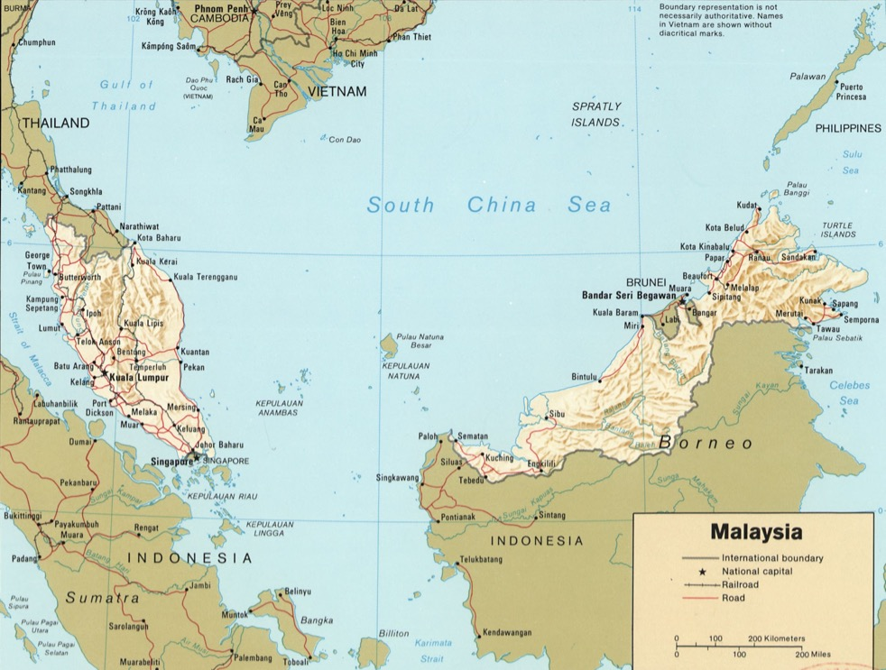
Tropical Rainforests in Malaysia
Malaysia is a country in South-East Asia, located near the equator.
Malaysia has large tropical rainforests which make up 62% of the country.
Malaysia’s rainforests are home to over 15,000 species of plants and over 1,600 species of animals.
14% of animal species in Malaysia’s rainforests are not found in any other country.
Map of Malaysia with the equator marked in purple.
Notes:
SPECIFICATION
AQA GCSE Geography
3.1.2 Section B: The living world
3.1.2.2 Tropical rainforests
Tropical rainforest ecosystems have a range of distinctive characteristics.
Tropical rainforests need to be managed to be sustainable.
TEACHER NOTES
It may be useful to point out the two different regions that make up Malaysia (Peninsula Malaysia and Eastern Malaysia, on the island of Borneo).
You may also want to point out where the equator is (marked in purple) and ask the class about its significance.

Slide 3
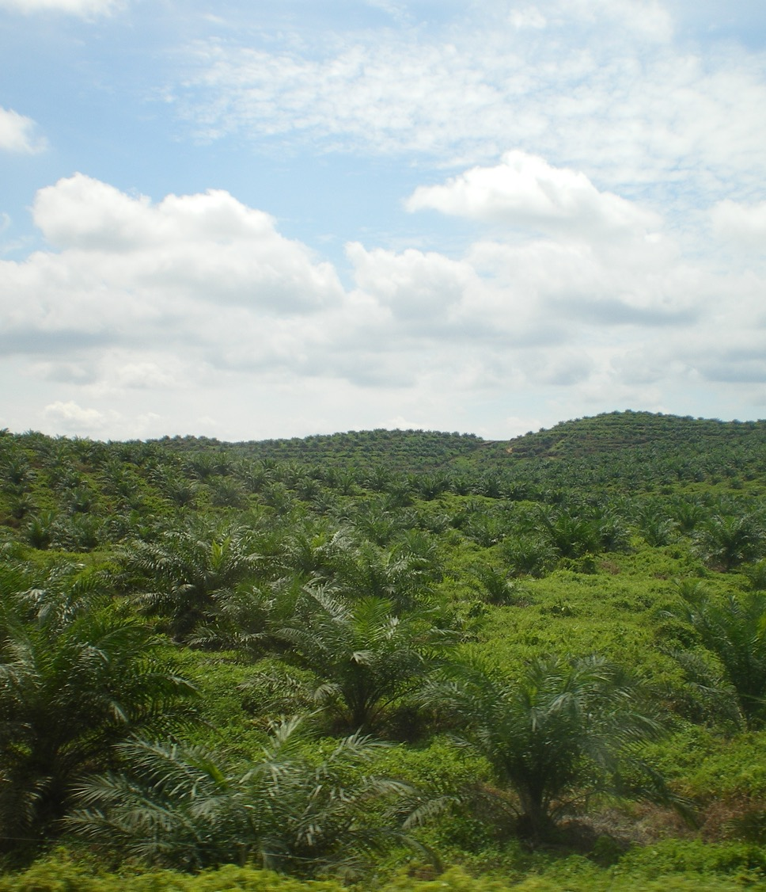
Deforestation in Malaysia
Deforestation is the removal of forests for the conversion of land to a different use.
Between 1990 and 2010, Malaysia lost 8.6% of its forests.
The main cause of deforestation today is logging and land clearing.
Companies remove forests to set up palm oil and rubber plantations.
Other drivers of deforestation include urbanisation and the expansion of infrastructure.
What impact might deforestation have on biodiversity?
Palm oil plantation in Eastern Malaysia, Wikimedia
Notes:
SPECIFICATION
AQA GCSE Geography
3.1.2 Section B: The living world
3.1.2.2 Tropical rainforests
Deforestation has economic and environmental impact
Causes of deforestation – subsistence and commercial farming, logging, road building, mineral extraction, energy development, settlement, population growth.
TEACHER NOTES
You may wish to ask the class what they think the impacts of deforestation would be on biodiversity.
You might also point out the photograph of a palm oil plantation in Malaysia, and ask the students what they think it might have looked like before deforestation.

Slide 4
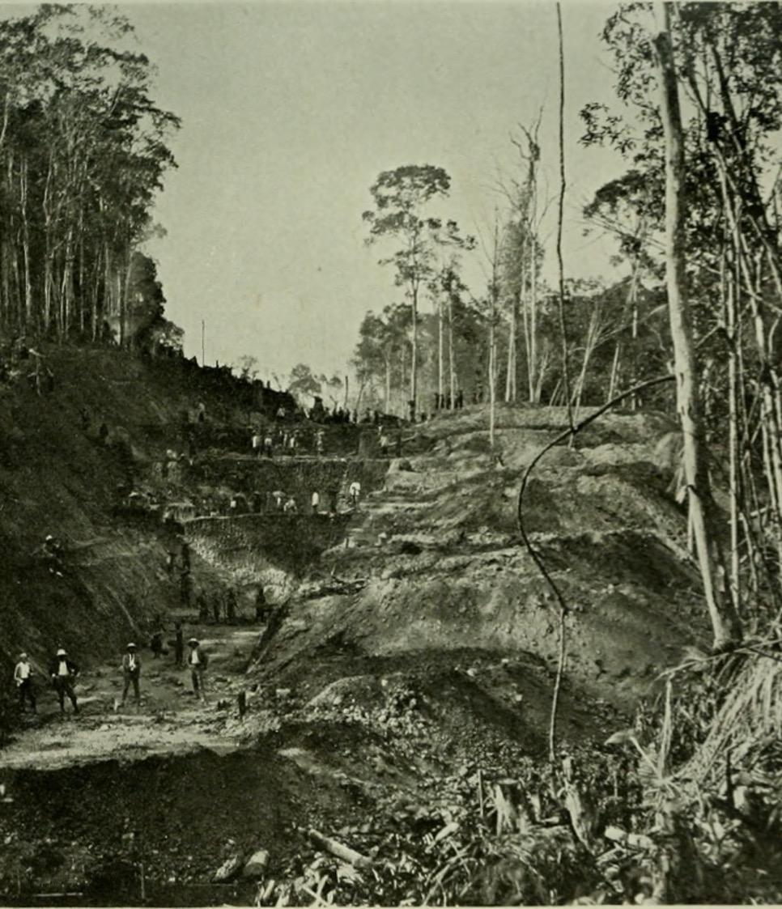
Deforestation and Empire
Malaysia was part of the British Empire from 1824 to 1957.
The British introduced new cash crops into Malaysia, including:
Rubber (from South America)
Palm oil (from West Africa)
The British set up plantations, which required clearing rainforests.
Many Malaysian people lost their land.
Labourers worked in poor conditions on the plantations.
By 1920, rubber plantations covered 2 million acres in Malaysia.
Forest clearing in British Malaya c.1907. Wikimedia
Notes:
SPECIFICATION
AQA GCSE Geography
3.1.2 Section B: The living world
3.1.2.2 Tropical rainforests
Deforestation has economic and environmental impact
Causes of deforestation – subsistence and commercial farming, logging, road building, mineral extraction, energy development, settlement, population growth.
TEACHER NOTES
You may wish to explain to the class that rubber (at this time) was a natural product, made from rubber trees.
You may wish to ask them what rubber would have been used for at this time (car tires, hoses, shoes), and why the British wanted to make so much rubber (commercial value, expansion of motorcar industry, WW1)

Slide 5
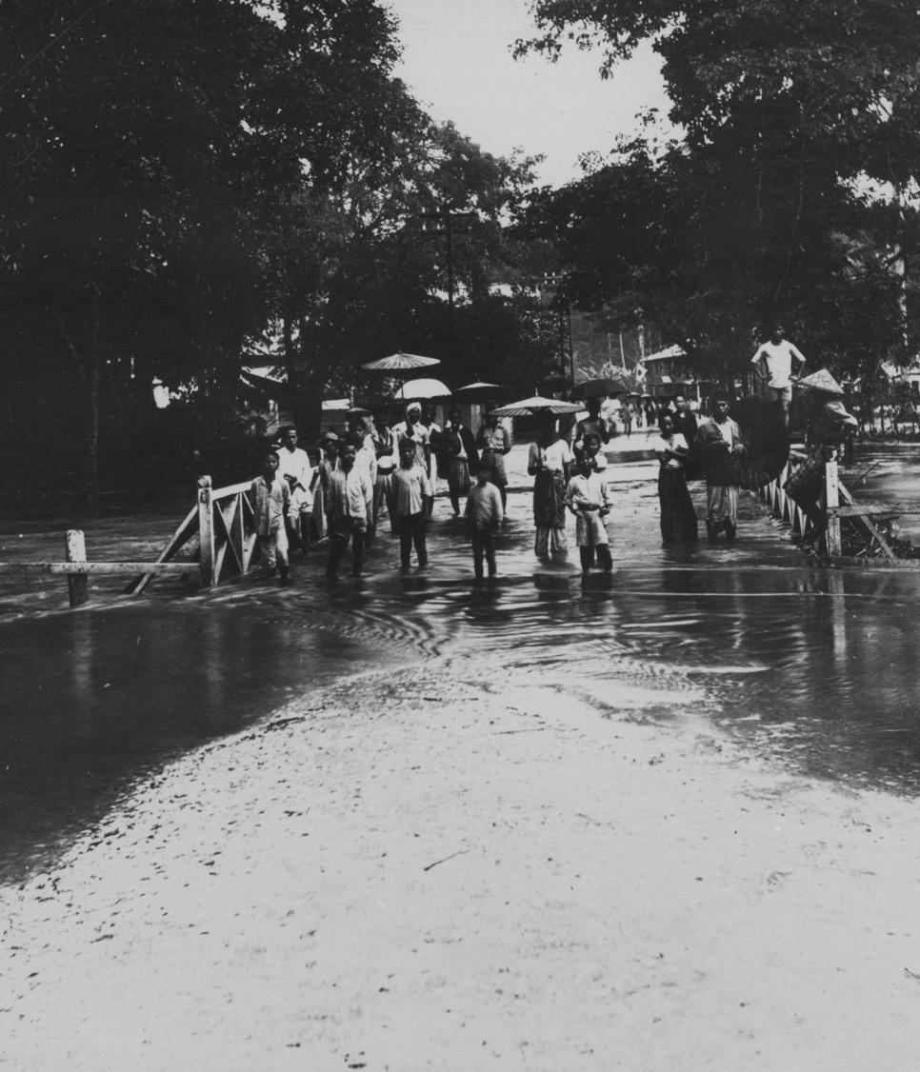
Impacts of Deforestation
Soil erosion
Removing trees makes the soil less stable. This can result in mudslides and make flooding worse.
Reduction in soil fertility
Removing trees reduces the nutrients which go into the soil, making it harder to grow different crops.
Loss of biodiversity
Thousands of plants and animals can only be found in the Malaysia’s rainforests.
Loss of culture and knowledge
People living in rainforest have unique knowledge of the environment which could be lost.
In what ways did colonialism contribute to deforestation and its impacts?
1926 flood, British Malaya, RCS, Cambridge University Library.
Notes:
SPECIFICATION
AQA GCSE Geography
3.1.2 Section B: The living world
3.1.2.2 Tropical rainforests
Deforestation has economic and environmental impact
Impacts of deforestation – economic development, soil erosion, contribution to climate change.
Value of tropical rainforests to people and the environment.
TEACHER NOTES
You may wish to discuss how and why colonialism might have contributed in the short- and long-term to these different impacts.

Slide 6
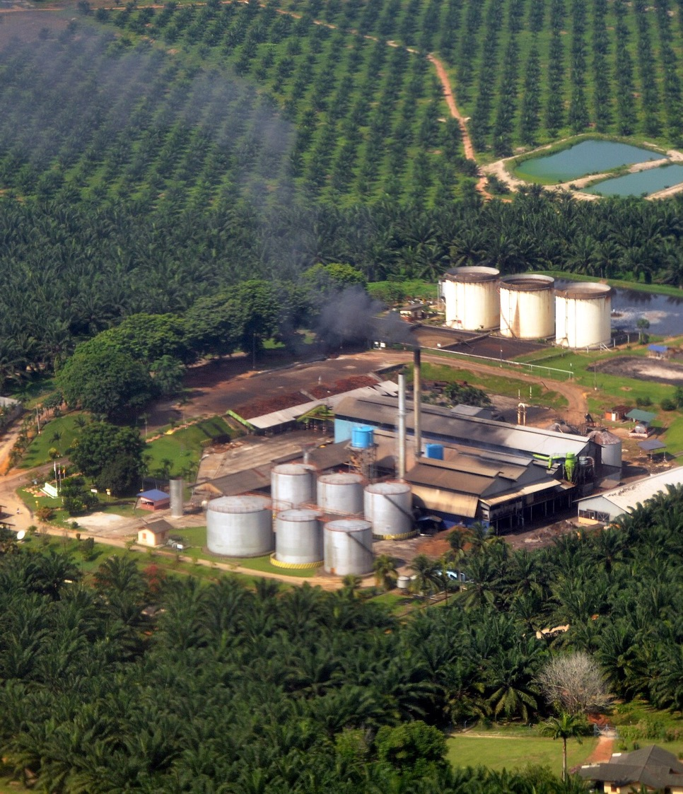
Deforestation After Independence
Malaysia was occupied by Japan during the Second World War.
Following this, Malaysia gained independence from the British Empire in 1957.
Deforestation continued, as the Malaysian economy relied on palm oil plantations.
Nonetheless, Malaysian geographers and scientists have played an important role in:
Measuring and mapping deforestation
Developing strategies to manage the rainforest sustainably.
Palm oil plantation, Malaysia. Wikimedia
Notes:
SPECIFICATION
AQA GCSE Geography
3.1.2 Section B: The living world
3.1.2.2 Tropical rainforests
Deforestation has economic and environmental impact
Impacts of deforestation – economic development, soil erosion, contribution to climate change.
Tropical rainforests need to be managed to be sustainable.

Slide 7


Lim Boo Liat
Born in Malaysia in 1926, under colonial rule.
Helped establish National Zoo of Malaysia in 1963.
Received PhD in Zoology from the Science University of Malaysia in 1977.
Travelled across South-East Asia studying rainforest biodiversity.
Advocated for preservation of rainforests.
National Zoo of Malaysia. Wikimedia
Notes:
SPECIFICATION
AQA GCSE Geography
3.1.2 Section B: The living world
3.1.2.2 Tropical rainforests
Deforestation has economic and environmental impact
Tropical rainforests need to be managed to be sustainable.
Value of tropical rainforests to people and the environment.
Strategies used to manage the rainforest sustainably – selective logging and replanting, conservation and education, ecotourism and international agreements about the use of tropical hardwoods, debt reduction.
TEACHER NOTEs
Lim Boo Liat’s career is a good example of the importance of zoos in conservation. You may wish to get the students to discuss how zoos help with conservation, including rainforest conservation, especially if they are more familiar with the idea of a zoo as simply a tourist destination.

Slide 8
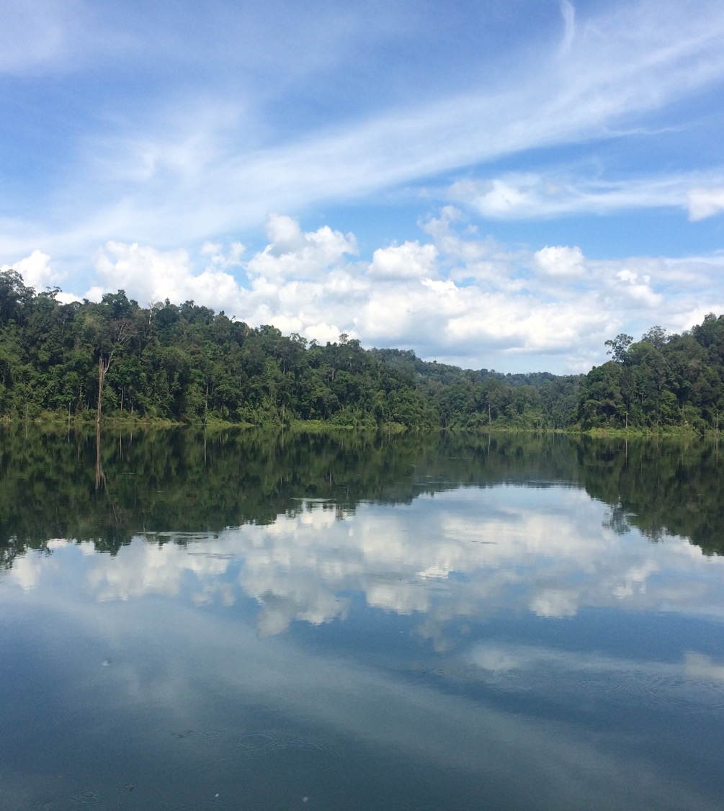

Salleh Mohd Nor
Born in Malaysia in 1940, under colonial rule.
Received PhD in Forestry Science from Michigan State University, USA.
Became director of the Forest Research Institute Malaysia in 1977.
Helped establish national parks to protect rainforests in Malaysia.
Belum-Temengor National Park, Malaysia
Notes:
SPECIFICATION
AQA GCSE Geography
3.1.2 Section B: The living world
3.1.2.2 Tropical rainforests
Deforestation has economic and environmental impact
Tropical rainforests need to be managed to be sustainable.
Value of tropical rainforests to people and the environment.
Strategies used to manage the rainforest sustainably – selective logging and replanting, conservation and education, ecotourism and international agreements about the use of tropical hardwoods, debt reduction.
TEACHER NOTES
Salleh Mohd Nor’s career is a good example of the importance of national parks for conservation, especially rainforest conservation. You may wish to discuss what a national park is and ask the class how this might help with rainforest conservation. You could also ask the class what rules would they put in place for a national park to be effective at conservation.

