Slide 1

Cold Environments
Environment & Empire
GCSE Geography
CASE STUDY
Arctic
Notes:
TEACHER NOTES
The aim of each teaching resource in this pack is to encourage students to explore:
The effects and consequences of empire on geography
The contributions of non-European people to the study of geography
The aim is therefore to both decolonise and diversify the teaching of geography.
SENSITIVITY GUIDANCE
Students may be unfamiliar with the appropriate language to identify Indigenous people, particularly those living in the Arctic.
We advise, particularly on slide two, that you explain the term “Indigenous people” to the class. We also advise that you explain that certain terms are now considered offensive, and that we should identify people by the terms they prefer to use themselves: for example, “Inuit” rather than “Eskimo”.
You might also wish to explain that there are many different Indigenous groups living in the Arctic, and that where possible, we should identify them separately. For example, there is a difference between the Inuit (who live mainly in modern-day Canada and Greenland) and the Yupik (who mainly living in modern-day Canada and North-Eastern Russia).
SPECIFICATION
AQA GCSE Geography
3.1.2 The living world
3.1.2.4 Cold environments
Cold environments (polar and tundra) have a range of distinctive characteristics.
Development of cold environments creates opportunities and challenges.
Cold environments are at risk from economic development.
COPYRIGHT AND TERMS
All content is provided under the Creative Commons Attribution 4.0 license: https://creativecommons.org/licenses/by/4.0/
Images rights are held by respective copyright holders
For further information about the project, please see https://environmentandempire.org.uk/

Slide 2
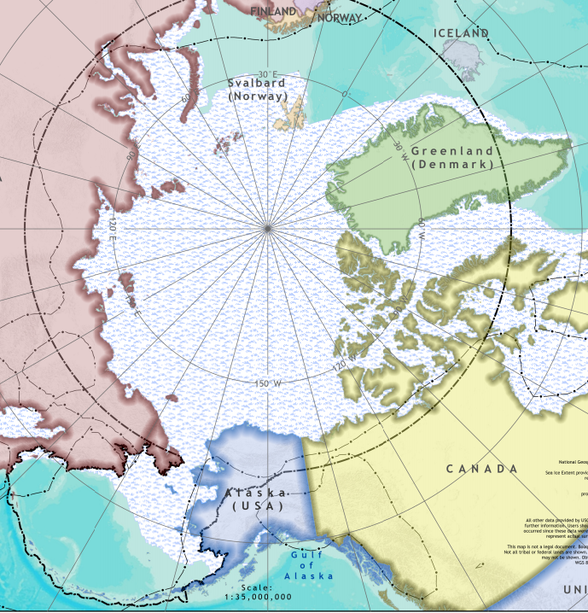
The Arctic Region
The Arctic is a polar region at the north of the Earth
It includes territory that is part of the following countries:
  United States, Canada, Denmark, Sweden, Iceland, Finland, Norway, and Russia
The Arctic is a cold environment which features:
  Snow and ice cover
  Permafrost
  Sea ice
  Glaciers
The average winter temperature in the Arctic is −40° C
Map of the Arctic. USGS. Public Domain.
Notes:
SPECIFICATION
AQA GCSE Geography
3.1.2 The living world
3.1.2.4 Cold environments
Cold environments (polar and tundra) have a range of distinctive characteristics.
The physical characteristics of a cold environment.
The interdependence of climate, permafrost, soils, plants, animals and people.

Slide 3
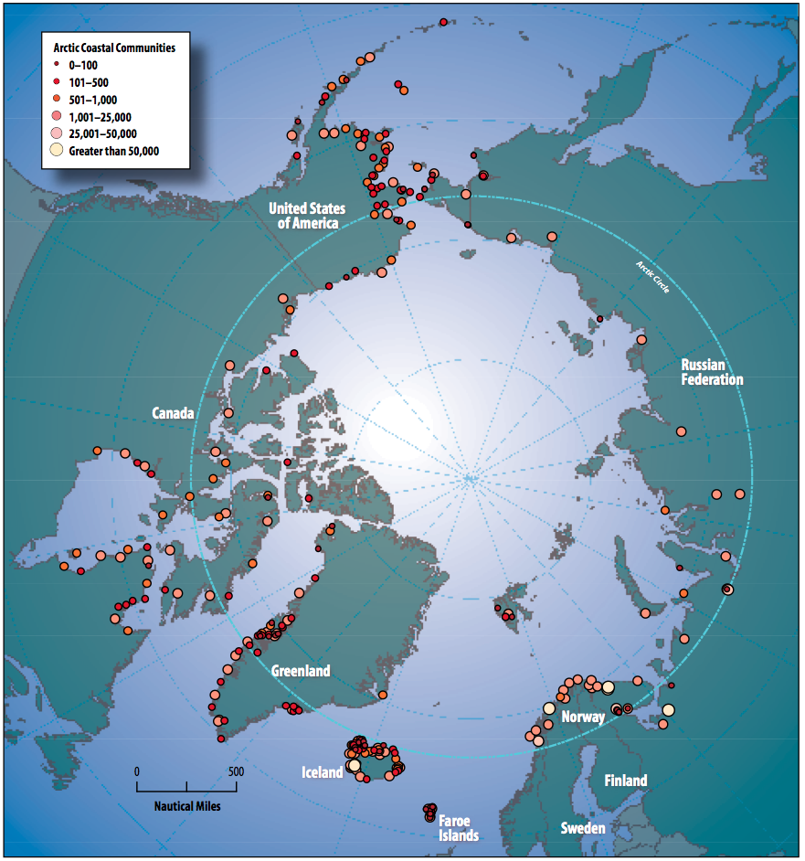
People in the Arctic
The Arctic is home to around 4 million people.
Of those, there are around 400,000 Indigenous people living in the Arctic today.
Indigenous people are the descendants of the original inhabitants of the region.
These include the Inuit, Chukchi, Yupik, Sami, Evenks, Yakuts, Aleut, Nenets, and other groups.
Map of Indigenous communities in the Arctic. Wikimedia.
Notes:
TEACHER NOTES
Students may be unfamiliar with the appropriate language to identify Indigenous people, particularly those living in the Arctic.
We advise that you explain the term “Indigenous people” to the class. We also advise that you explain that certain terms are now considered offensive, and that we should identify people by the terms they prefer to use themselves: for example, “Inuit” rather than “Eskimo”.
You might also wish to explain that there are many different Indigenous groups living in the Arctic, and that where possible, we should identify them separately. For example, there is a difference between the Inuit (who live mainly in modern-day Canada and Greenland) and the Yupik (who mainly living in modern-day Canada and North-Eastern Russia).
SPECIFICATION
AQA GCSE Geography
3.1.2 The living world
3.1.2.4 Cold environments
Cold environments (polar and tundra) have a range of distinctive characteristics.
The interdependence of climate, permafrost, soils, plants, animals and people.

Slide 4
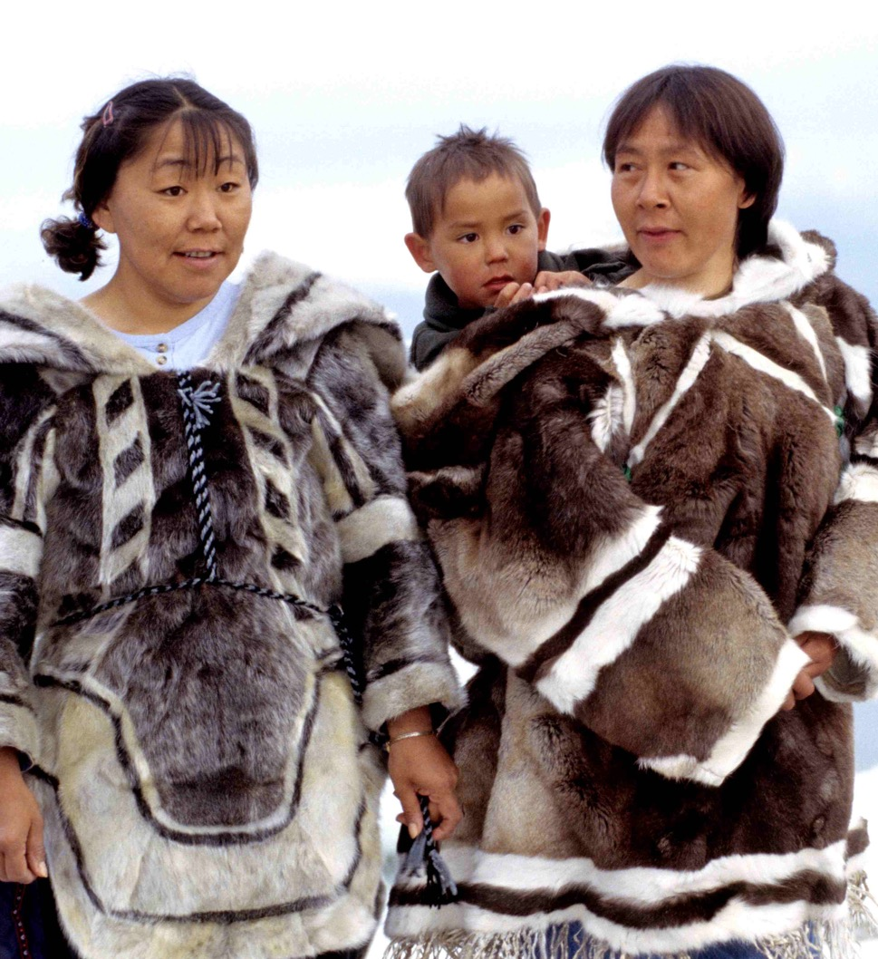
Arctic Life
Indigenous people, such as the Inuit, had already adapted their ways of living to suit the cold environment of the Arctic.
The Inuit understood the interdependence of the climate, soil, plants, animals, and people living in the Arctic.
  They built seasonal winter and summer houses.
  They studied snow patterns and ice flows to help navigate.
  They trained dogs to pull sledges and hunt.
  They made fur clothing to keep warm.
European explorers relied on Indigenous people in order to navigate and survive in the Arctic.
Inuit clothing, 1999. Wikimedia
Notes:
SPECIFICATION
AQA GCSE Geography
3.1.2 The living world
3.1.2.4 Cold environments
Cold environments (polar and tundra) have a range of distinctive characteristics.
The physical characteristics of a cold environment.
The interdependence of climate, permafrost, soils, plants, animals and people.

Slide 5
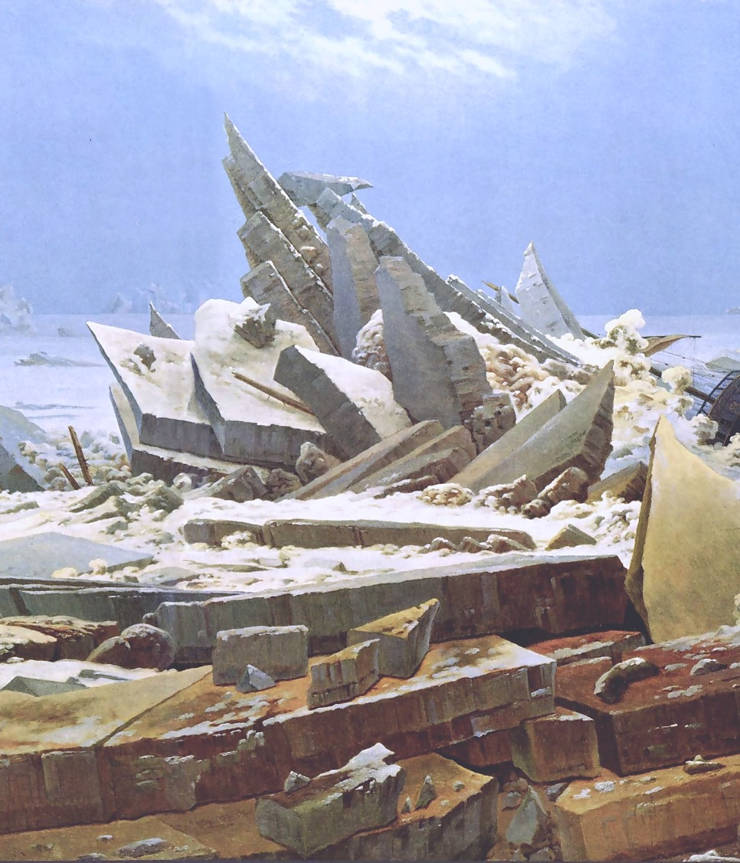
Arctic Empires
European countries colonised the Arctic from around 1600 onwards.
European countries wanted to extract resources from the Arctic, including:
  Fur
  Fish
  Whale blubber
  Coal
  Minerals
They also wanted to find a northern sailing route between the Atlantic and Pacific Oceans.
This is known as the Northwest Passage.
"Das Eismeer" (The Sea of Ice) by Caspar David Friedrich. Wikimedia.
Notes:
SPECIFICATION
AQA GCSE Geography
3.1.2 The living world
3.1.2.4 Cold environments
Development of cold environments creates opportunities and challenges.
A case study of a cold environment to illustrate:
development opportunities in cold environments: mineral extraction, energy, fishing and tourism
challenges of developing cold environments: extreme temperature, inaccessibility, provision of buildings and infrastructure.
Cold environments are at risk from economic development.
The value of cold environments as wilderness areas and why these fragile environments should be protected.
Strategies used to balance the needs of economic development and conservation in cold environments – use of technology, role of governments, international agreements and conservation groups.

Slide 6
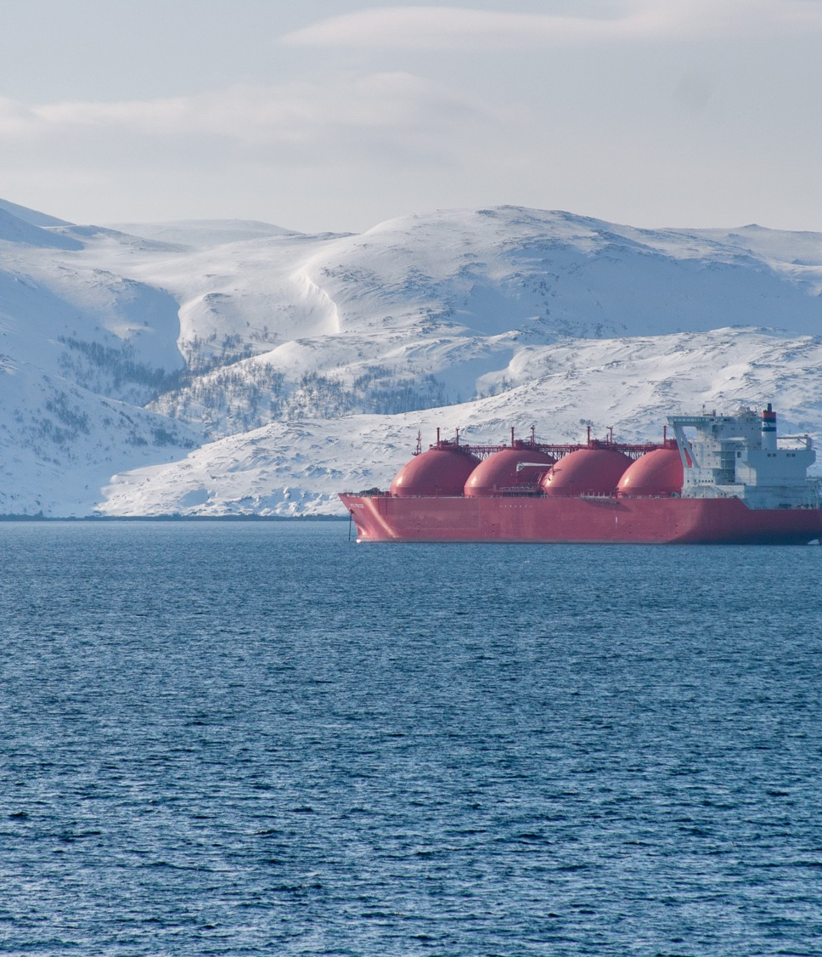
Arctic Development
Today, the Arctic is seen as a development opportunity.
European and North American countries still want to extract resources from the Arctic.
This includes fish, coal, minerals, and oil.
However, the Arctic is also under threat of climate change and overdevelopment.
Indigenous people are rarely properly consulted on development.
Indigenous people rarely benefit from development.
Is this a continuation of colonialism?
LNG Carrier, Norwegian Coast. Wikimedia
Notes:
TEACHER NOTES
You may wish to ask the class, or use the accompanying worksheet, to discuss the similarities and differences between the era of colonialism and development in the arctic today.
SPECIFICATION
AQA GCSE Geography
3.1.2 The living world
3.1.2.4 Cold environments
Development of cold environments creates opportunities and challenges.
A case study of a cold environment to illustrate:
development opportunities in cold environments: mineral extraction, energy, fishing and tourism
challenges of developing cold environments: extreme temperature, inaccessibility, provision of buildings and infrastructure.
Cold environments are at risk from economic development.
The value of cold environments as wilderness areas and why these fragile environments should be protected.
Strategies used to balance the needs of economic development and conservation in cold environments – use of technology, role of governments, international agreements and conservation groups.

Slide 7
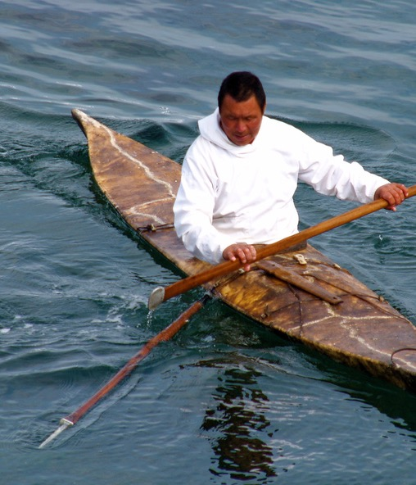
Indigenous Knowledge
Today, Indigenous people continue to play a significant role in developing our understanding of the Arctic.
They monitor and record the effects of climate change and development on the Arctic.
They propose alternative solutions, based on traditional Indigenous knowledge, to climate change and development in the Arctic.
Yet Indigenous contributions are not always properly acknowledged or valued.
Greenland Kayaker, 2006. Wikimedia
Notes:
SPECIFICATION
AQA GCSE Geography
3.1.2 The living world
3.1.2.4 Cold environments
Development of cold environments creates opportunities and challenges.
A case study of a cold environment to illustrate:
development opportunities in cold environments: mineral extraction, energy, fishing and tourism
challenges of developing cold environments: extreme temperature, inaccessibility, provision of buildings and infrastructure.
Cold environments are at risk from economic development.
The value of cold environments as wilderness areas and why these fragile environments should be protected.
Strategies used to balance the needs of economic development and conservation in cold environments – use of technology, role of governments, international agreements and conservation groups.

Slide 8
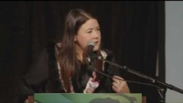
LNG Carrier, Norwegian Coast. Wikimedia
Notes:
TEACHER NOTES
5 minutes 55 seconds video (internet connection required). ”Climate Lens”, Assembly of First Nations.
You may wish to explain that “First Nations” refers to the Indigenous people of Canada.
You may wish to ask the students to pay attention to the roles that Indigenous people play in understanding the Arctic environment, managing economic development, and responding to climate change.
Click the PowerPoint presentation, or copy and paste the direct link to the video (Free, YouTube): https://youtu.be/64fi-1-oDrY
Further videos and information related to this can be found on the following website: https://climateatlas.ca/indigenous/first-nations
SPECIFICATION
AQA GCSE Geography
3.1.2 The living world
3.1.2.4 Cold environments

Slide 9
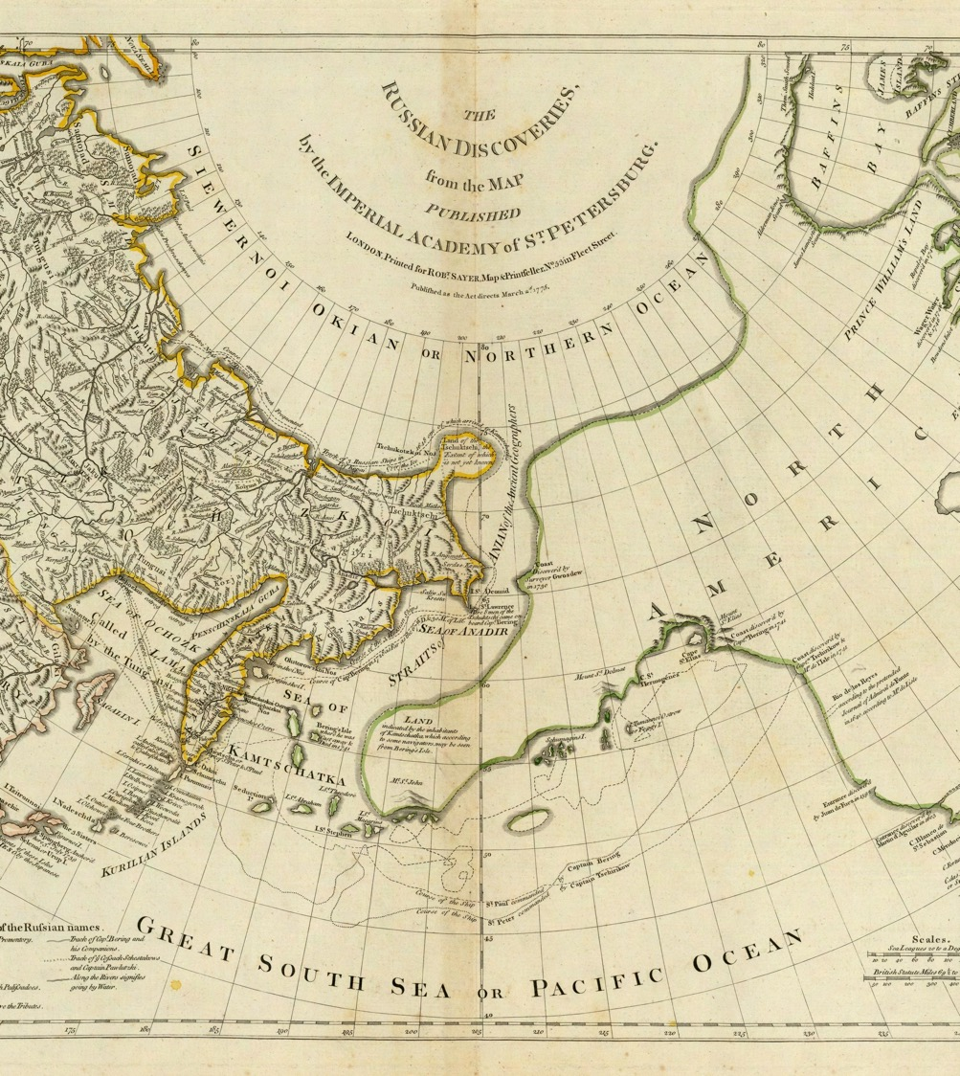
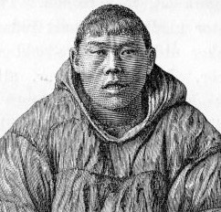
Nikolai Daurkin
Born into a Chukchi family in Siberia around 1730.
Captured by a Russian explorer as a boy.
Trained at the Irkutsk Navigational School in Siberia.
Surveyed the Bering Strait in the 1760s.
Worked as a navigator for Russian navy.
Helped map the Siberian-Alaskan coastline.
”Great South Sea or Pacific Ocean”. Public Domain.
Notes:
TEACHER NOTES
Highlight the following to students:
Daurkin is a good example of how European explorers relied on Indigenous people to navigate and map the Arctic.
Daurkin is also a reminder of the violence of colonialism—he was captured and forced to learn Russian as a young boy.
The Russian Empire wanted to expand into Siberia and Alaska in the eighteenth century, in order to secure territory and trade in fur.
SPECIFICATION
AQA GCSE Geography
3.1.2 The living world
3.1.2.4 Cold environments
Cold environments (polar and tundra) have a range of distinctive characteristics.
The physical characteristics of a cold environment.
The interdependence of climate, permafrost, soils, plants, animals and people.
Cold environments are at risk from economic development.
The value of cold environments as wilderness areas and why these fragile environments should be protected.
Strategies used to balance the needs of economic development and conservation in cold environments – use of technology, role of governments, international agreements and conservation groups.

Slide 10
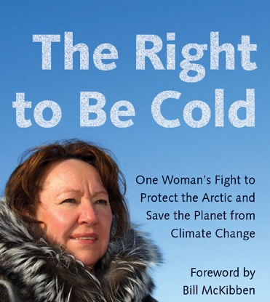
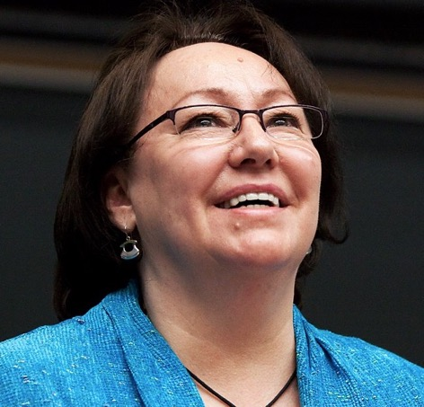
Sheila Watt-Cloutier
Born into a Canadian Inuit family in 1953.
Studied at McGill University, Canada in 1970s.
Elected as President of the Inuit Circumpolar Council in 1995.
Campaigns for legal and scientific action on climate change in the Arctic.
Published influential book The Right to Be Cold in 2015.
Notes:
TEACHER NOTES
Highlight the following to students:
Watt-Cloutier is a good example of how First Nations people continue to play an important role in understanding the Arctic environment.
Watt-Cloutier is a good example of how First Nations people are responding to climate change and economic development.
Watt-Cloutier is also a reminder of the legacies of colonialism—she was taken from her family forced to attend a “residential school” in Canada as a child.
SPECIFICATION
AQA GCSE Geography
3.1.2 The living world
3.1.2.4 Cold environments
Cold environments (polar and tundra) have a range of distinctive characteristics.
The physical characteristics of a cold environment.
The interdependence of climate, permafrost, soils, plants, animals and people.
Cold environments are at risk from economic development.
The value of cold environments as wilderness areas and why these fragile environments should be protected.
Strategies used to balance the needs of economic development and conservation in cold environments – use of technology, role of governments, international agreements and conservation groups.

